Slide 1
Bernstein Bounds for Caustics
Zhimin Fan¹ Chen Wang¹ Yiming Wang¹ Boxuan Li¹
Yuxuan Guo¹ Ling-Qi Yan² Yanwen Guo¹ Jie Guo¹
¹Nanjing University ²University of California, Santa Barbara

Slide 2
Rendering sharp caustics is difficult!
Path guiding [Müller et al. 2017]
SPPM [Hachisuka et al. 2009]
Blurring and noise
Extremely slow to converge

Slide 3
Related works
Point sampling
SMS [Zeltner20]
MPG [Fan23]
Region analysis
Path Cuts [Wang20]
Specular Polynomials [Fan24]
Ours
MNEE [Hanika15]
ME [Jakob12]
Spindle Test [Walter09]

Slide 4
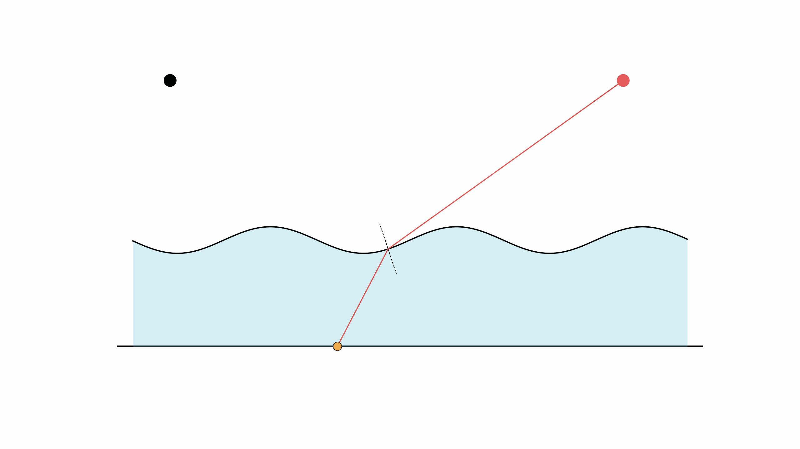
Manifold: deterministic init.
Manifold next event estimation [Hanika et al. 2015]

Slide 5
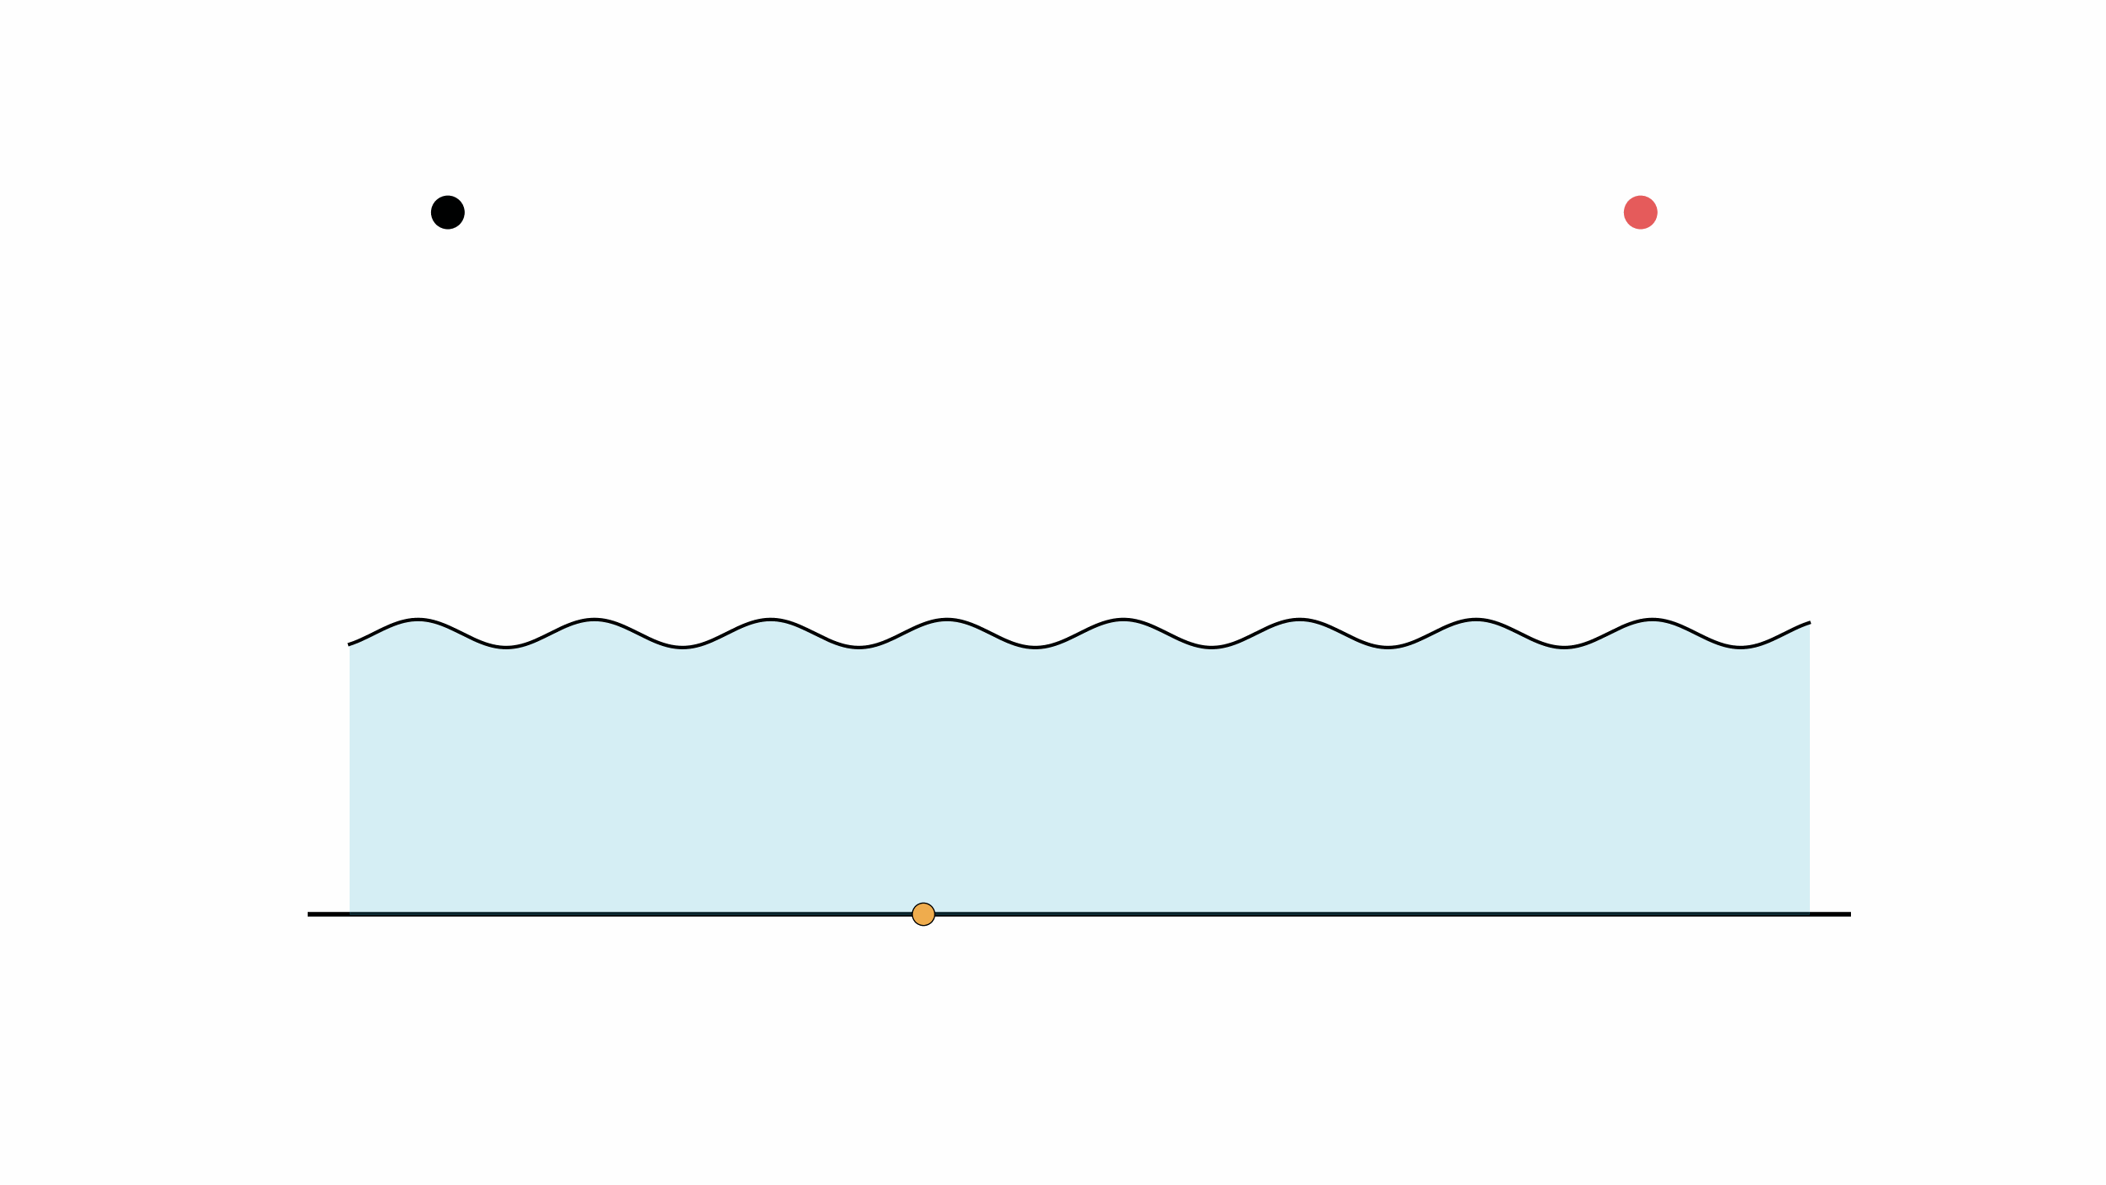
Manifold: uniform stochastic sampling
Specular manifold sampling [Zeltner et al. 2020]

Slide 6


Deterministic search for specular paths
Select triangle tuples first (our focus)
Then find solutions using Newton’s method or polynomial solvers
[Walter et al. 2009] [Wang et al. 2020]
[Fan et al. 2024]
$$t=t_{tuple selection}+\left|S\right|{ t}_{solve each tuple}$$
?
$$S$$
Configurations
Candidate set
Solutions

Slide 7
Motivation: position
A triangle tuple’s caustics are in a small region
Example
From left to right
Need to solve at most 0, 2, 1 triangle tuples

Slide 8
Motivation: irradiance
If the irradiance contribution is low
We can sample it with a small probability
Without introducing evident noise

Slide 9
How to obtain bounds?
Interval arithmetic
[Wang et al. 2020]
(ignore correlation, loose)
Fitted distribution
[Fan et al. 2023]*
(still rely on the initial)
Sample range
[Loubet et al. 2020]
(not conservative, leaking)
Notes:
Fan et al. 2023 uses vmf instead of histograms. Nevertheless, the issue persists.

Slide 10
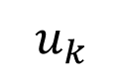
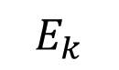
Key idea: bound the range analytically
Irradiance bounds
$$E_{k}$$
$$u_{k}$$
Position bounds

Slide 11
Rendering phase: bound-driven sampling
A good bound should be tight and fast to compute
$$t=t_{tuple selection}+\left|S\right|{ t}_{solve each tuple}$$
?
$$S$$
Configurations
Candidate set
Solutions

Slide 12
PRELIMINARIES

Slide 13
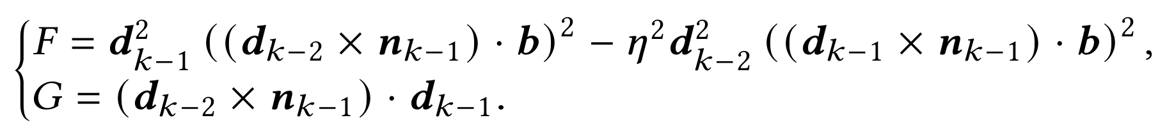
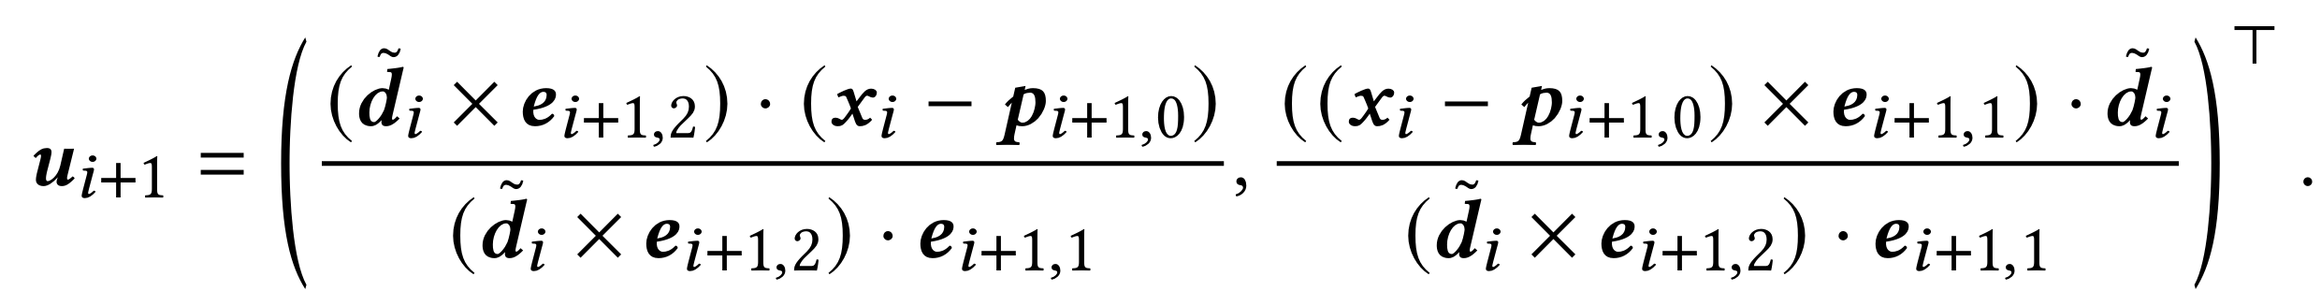
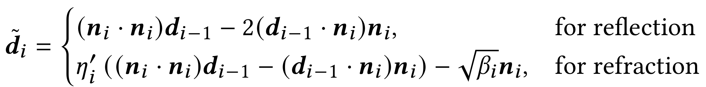
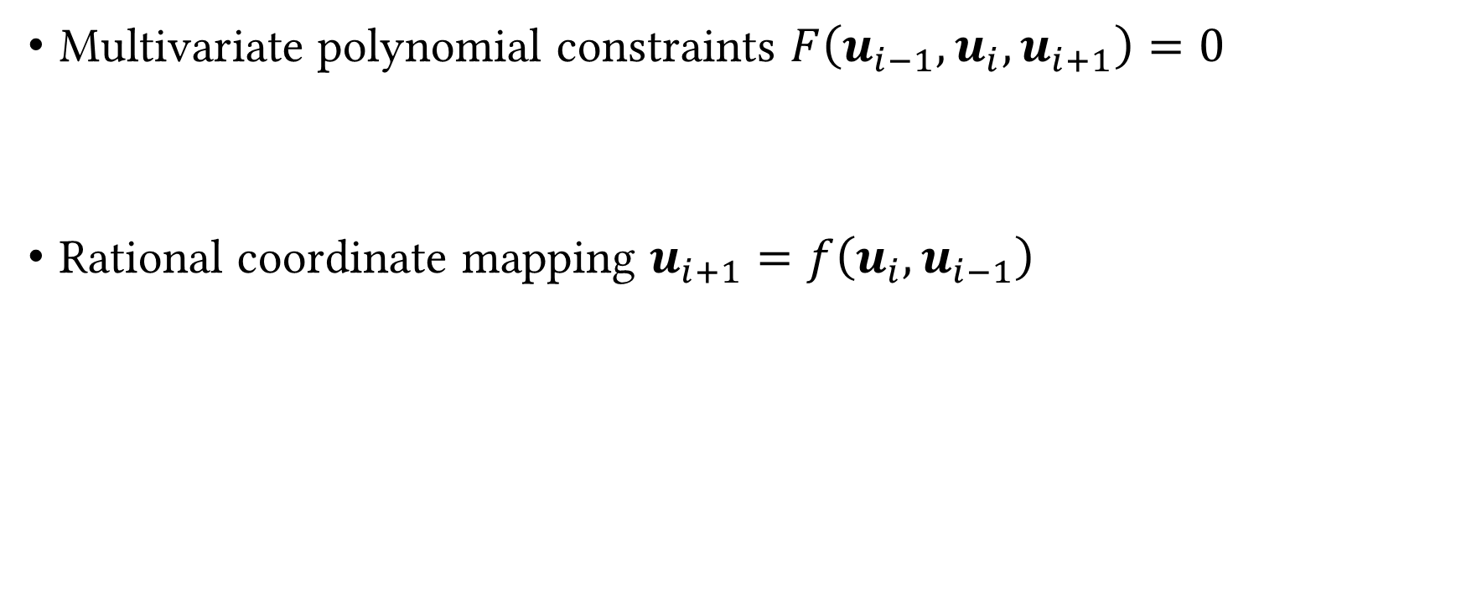
Recap: Specular Polynomials [Fan et al. 2024]
Multivariate polynomial constraints $F\left(u_{i−1},u_{i},u_{i+1}\right)=0$
Rational coordinate mapping $u_{i+1}=f\left(u_{i},u_{i−1}\right)$

Slide 14
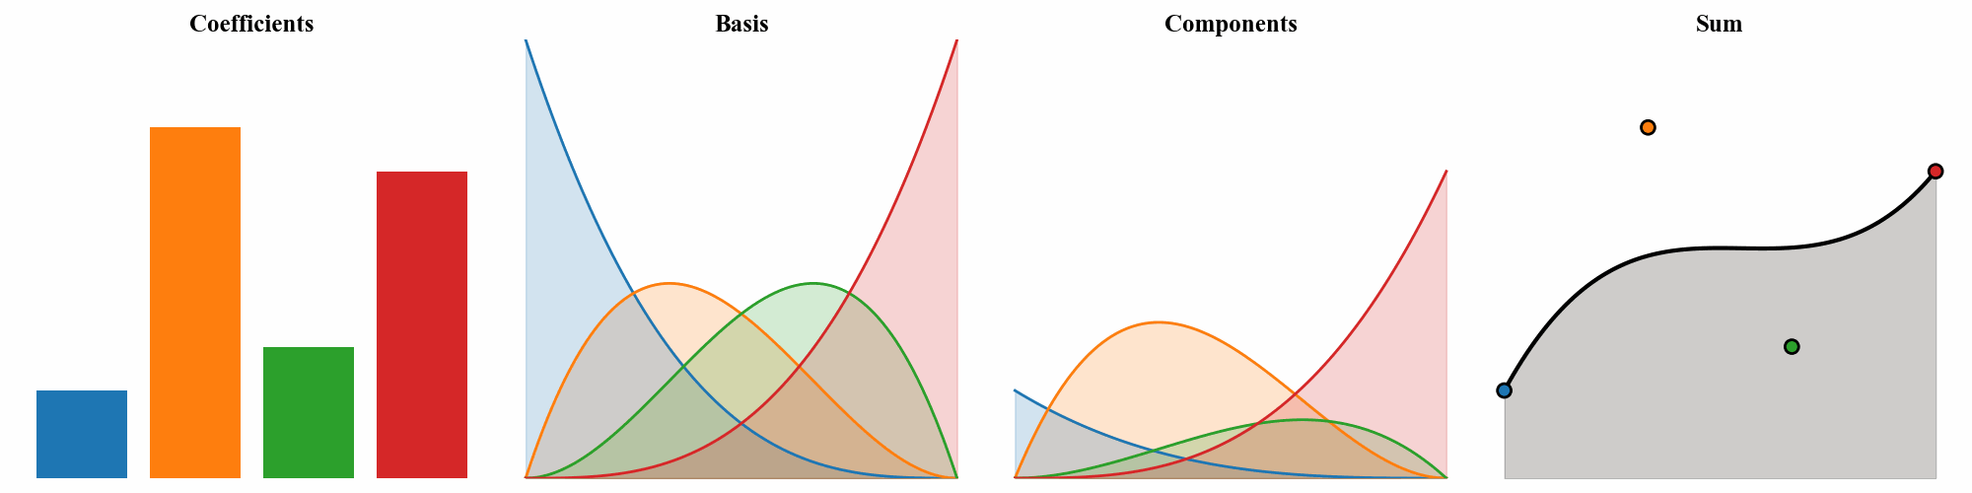
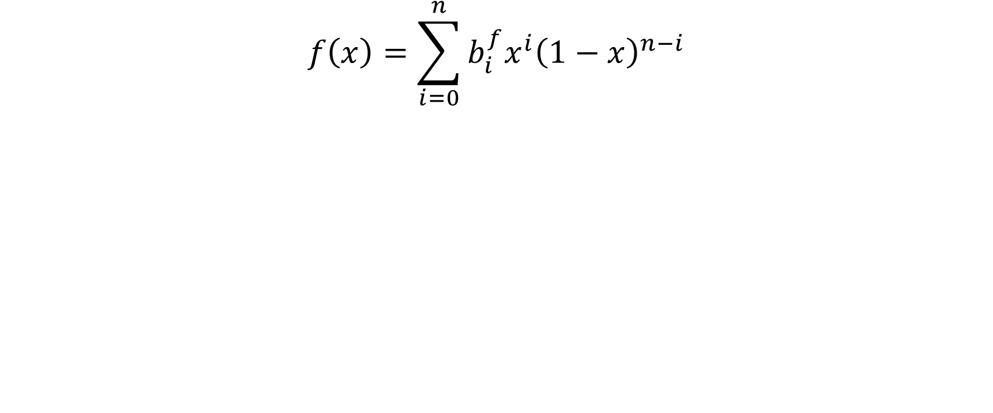
Bernstein polynomial basis
$$f\left(x\right)=\sum_{i=0}^{n}{b_{i}^{f}x^{i}{\left(1−x\right)}^{n−i}}$$

Slide 15
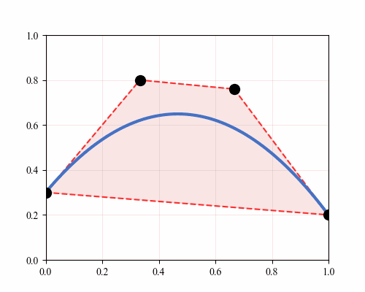
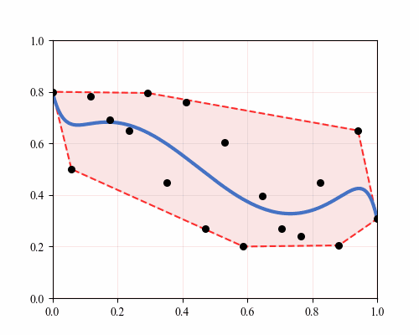
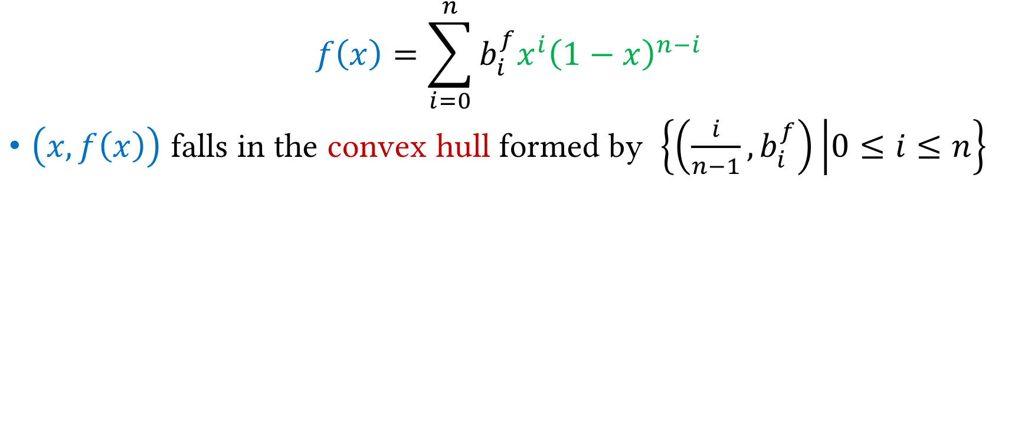
Bounding the range of polynomials
$$f\left(x\right)=\sum_{i=0}^{n}{b_{i}^{f}x^{i}{\left(1−x\right)}^{n−i}}$$
$\left(x,f\left(x\right)\right)$ falls in the convex hull formed by $\left\{\left(\frac{i}{n−1}, b_{i}^{f}\right) | 0≤i≤n\right\}$

Slide 16
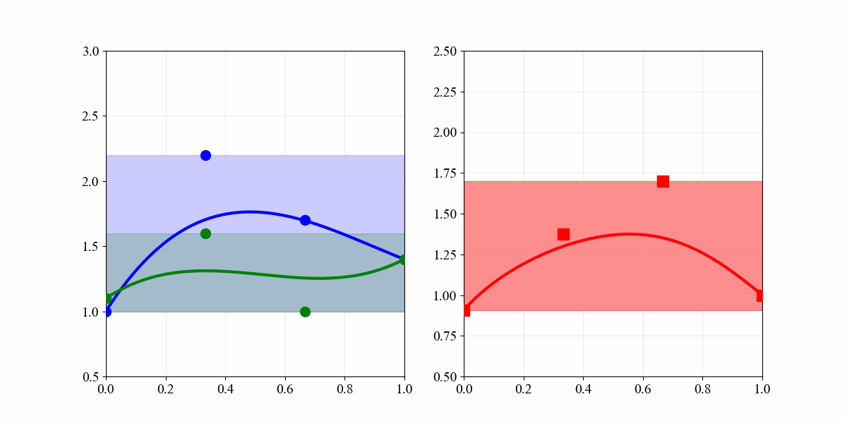
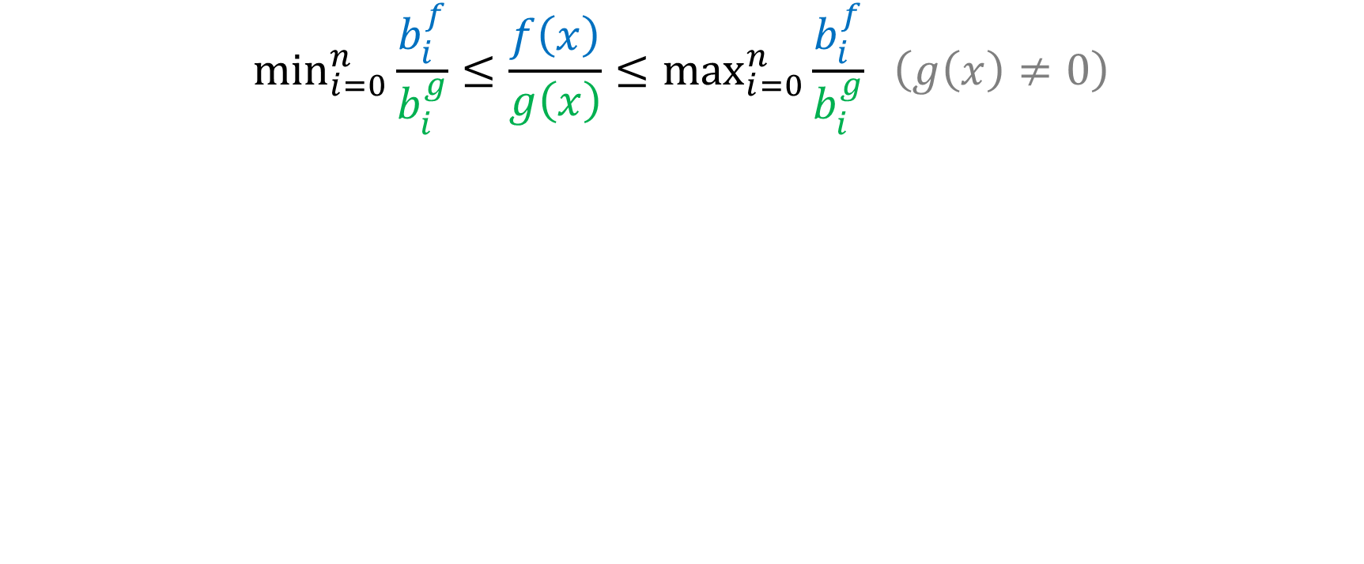
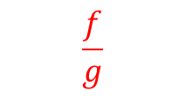
Bounding the range of rational functions
$$\min_{i=0}^{n}{\frac{b_{i}^{f}}{b_{i}^{g}}}≤\frac{f\left(x\right)}{g\left(x\right)}≤\max_{i=0}^{n}{\frac{b_{i}^{f}}{b_{i}^{g}}} \left(g\left(x\right)≠0\right)$$
[Narkawicz et al. 2012]
$$\frac{f}{g}$$

Slide 17
METHODOLOGY

Slide 18
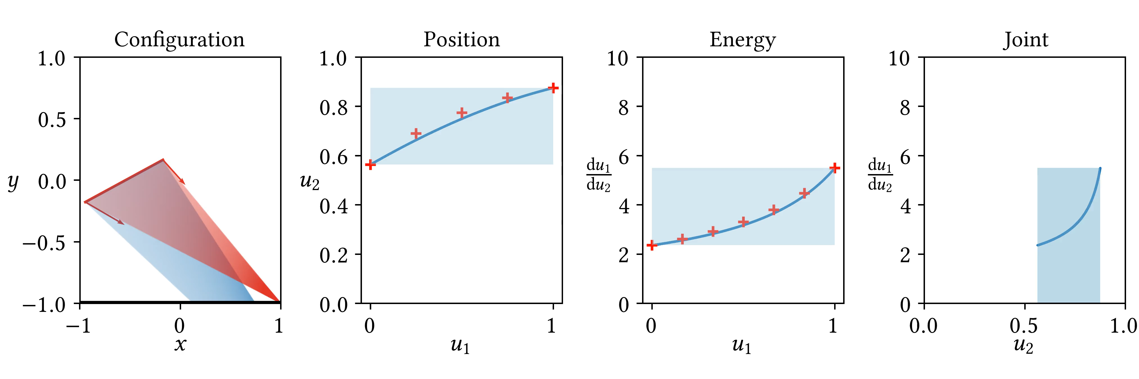
Running examples (animation)
Represent caustics with Bernstein polynomials to get their bounds

Slide 19
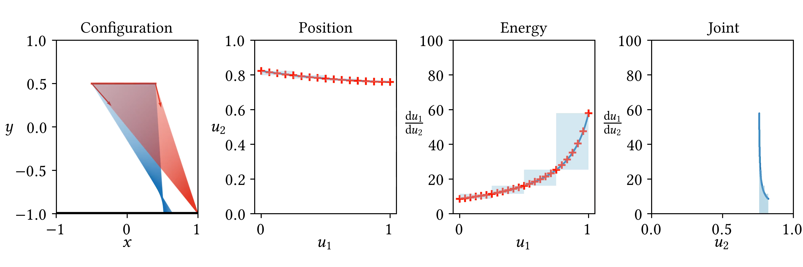
Piecewise constant bounds
Improve tightness
Handle singularities

Slide 20
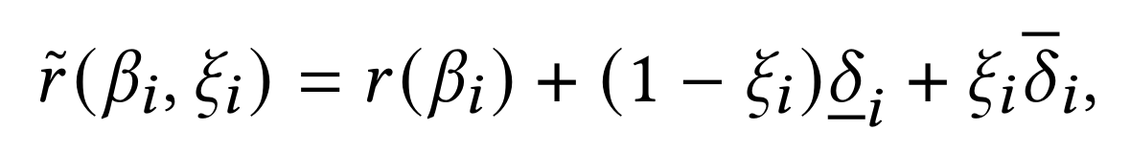
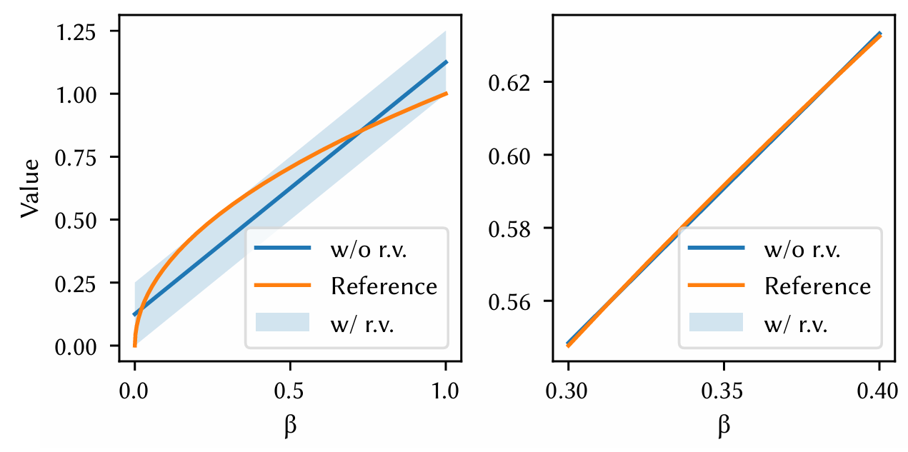
Approximation with remainder variables
Handle non-rational factors
Degree reduction

Slide 21
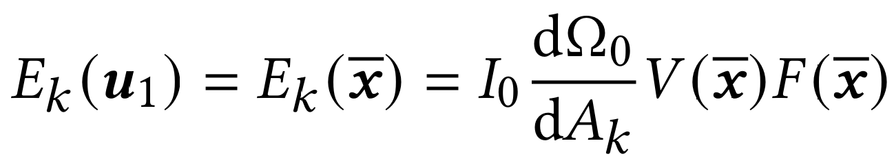
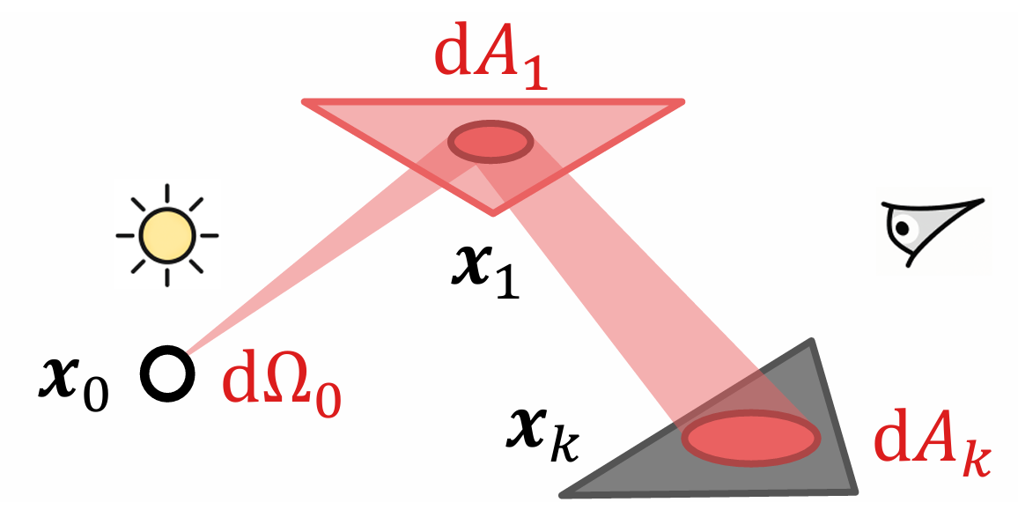
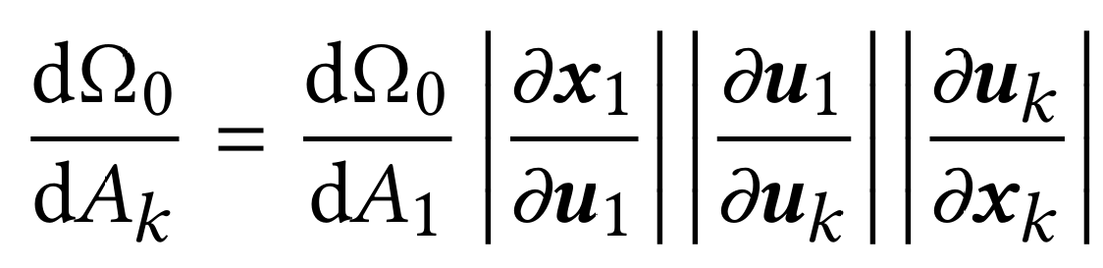
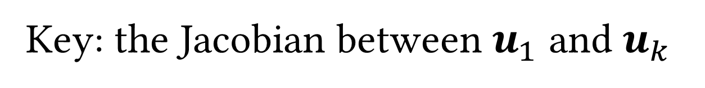
Irradiance
Key: the Jacobian between $u_{1}$ and $u_{k}$

Slide 22
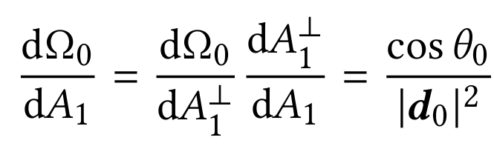
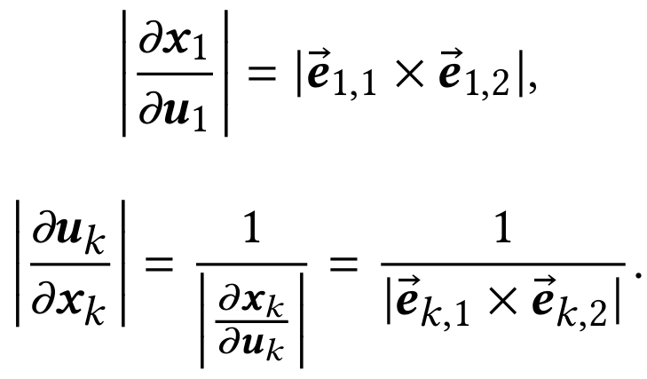
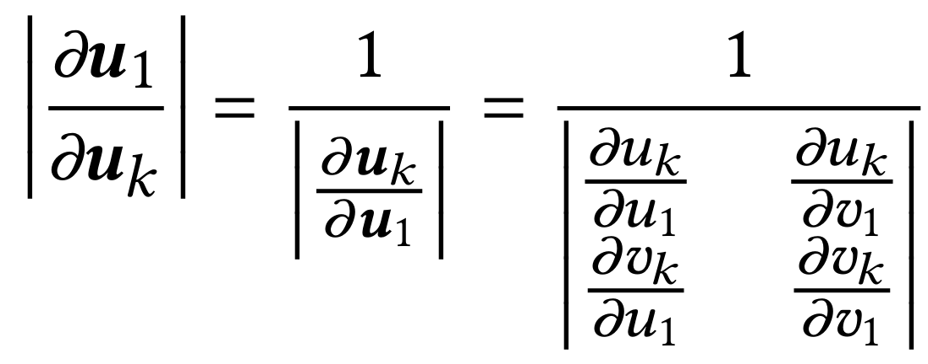
Irradiance

Slide 23
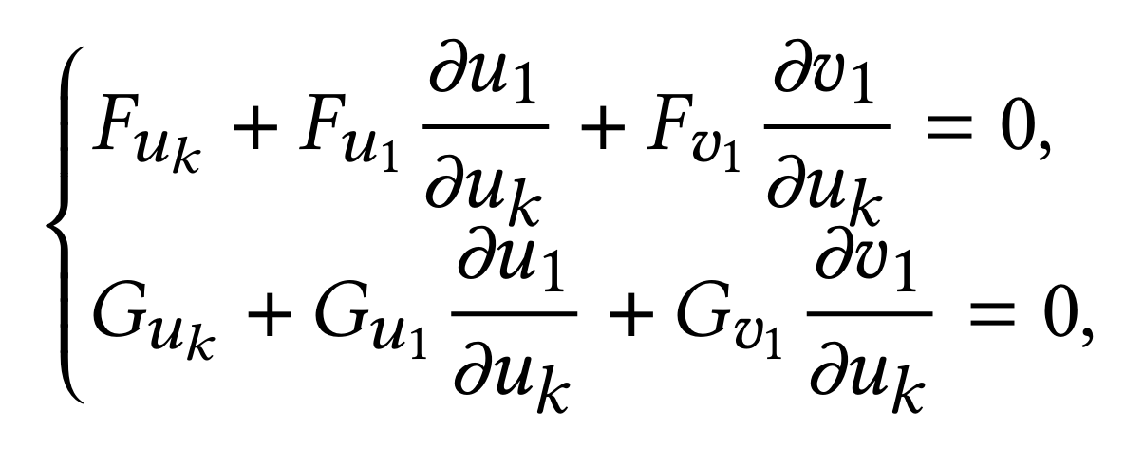
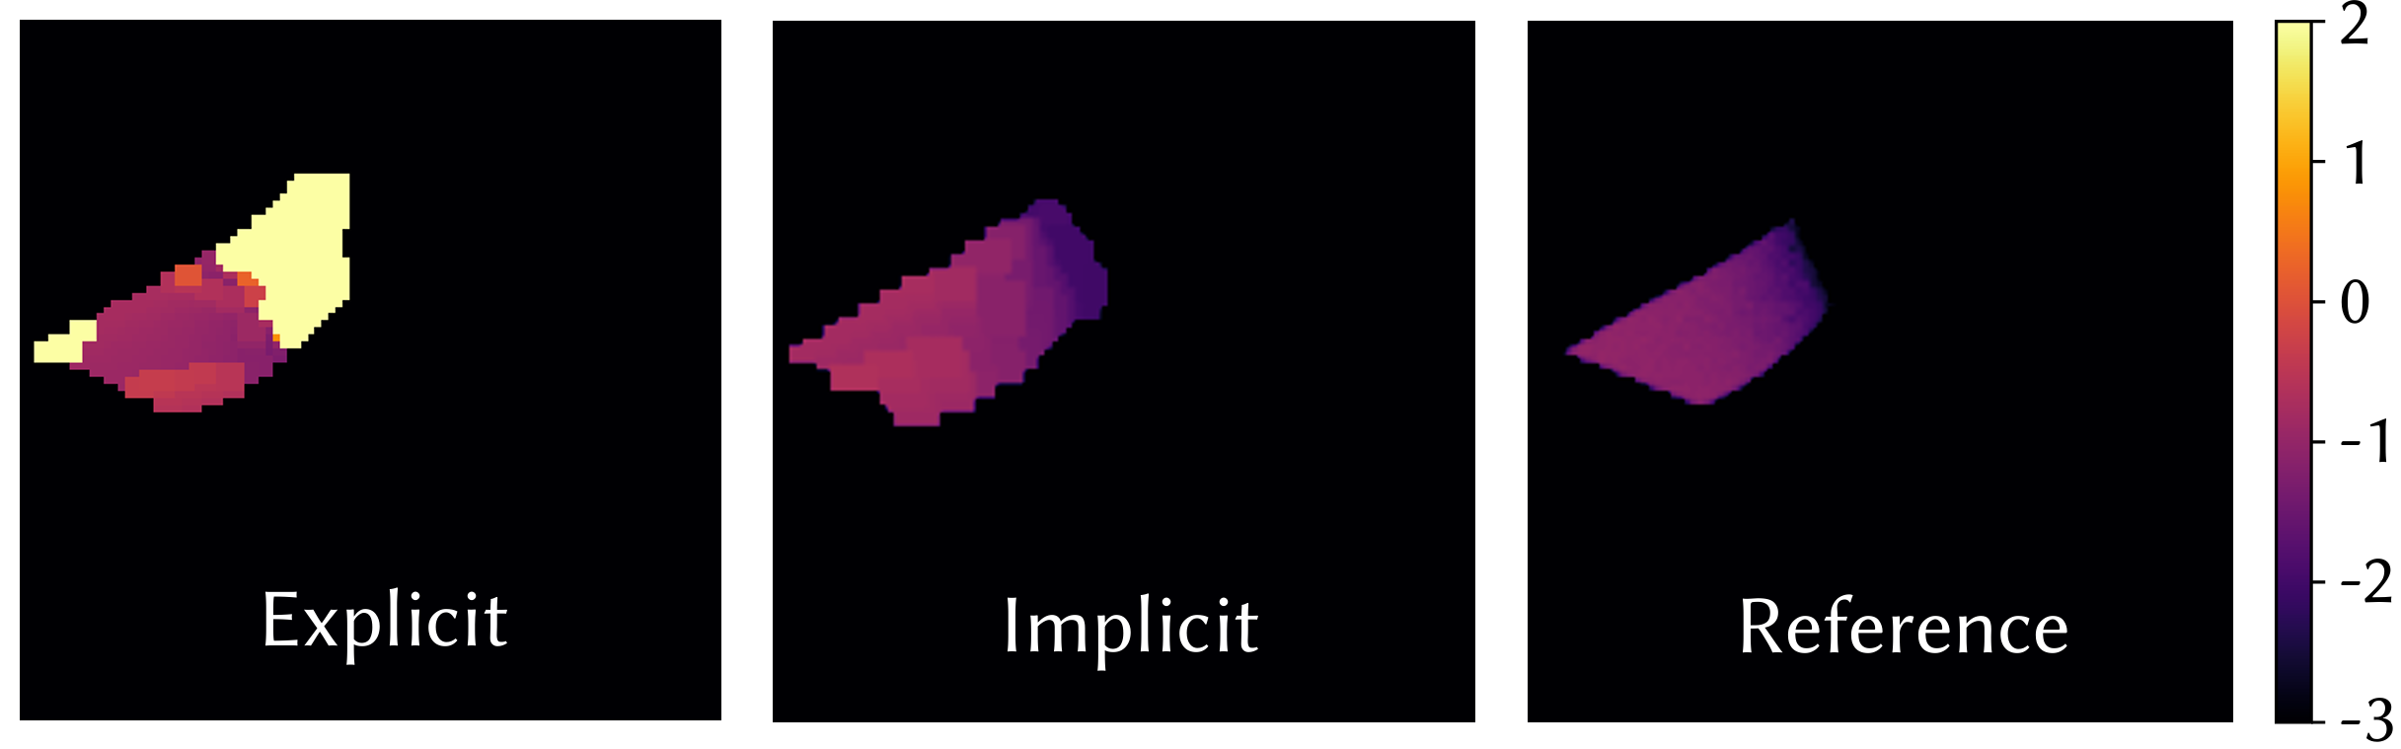
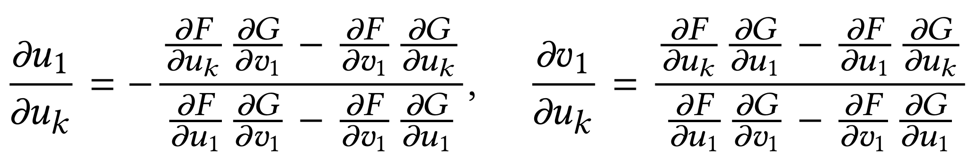
Irradiance: implicit differentials
Trade #variables for lower degrees and less refractive approximations

Slide 24
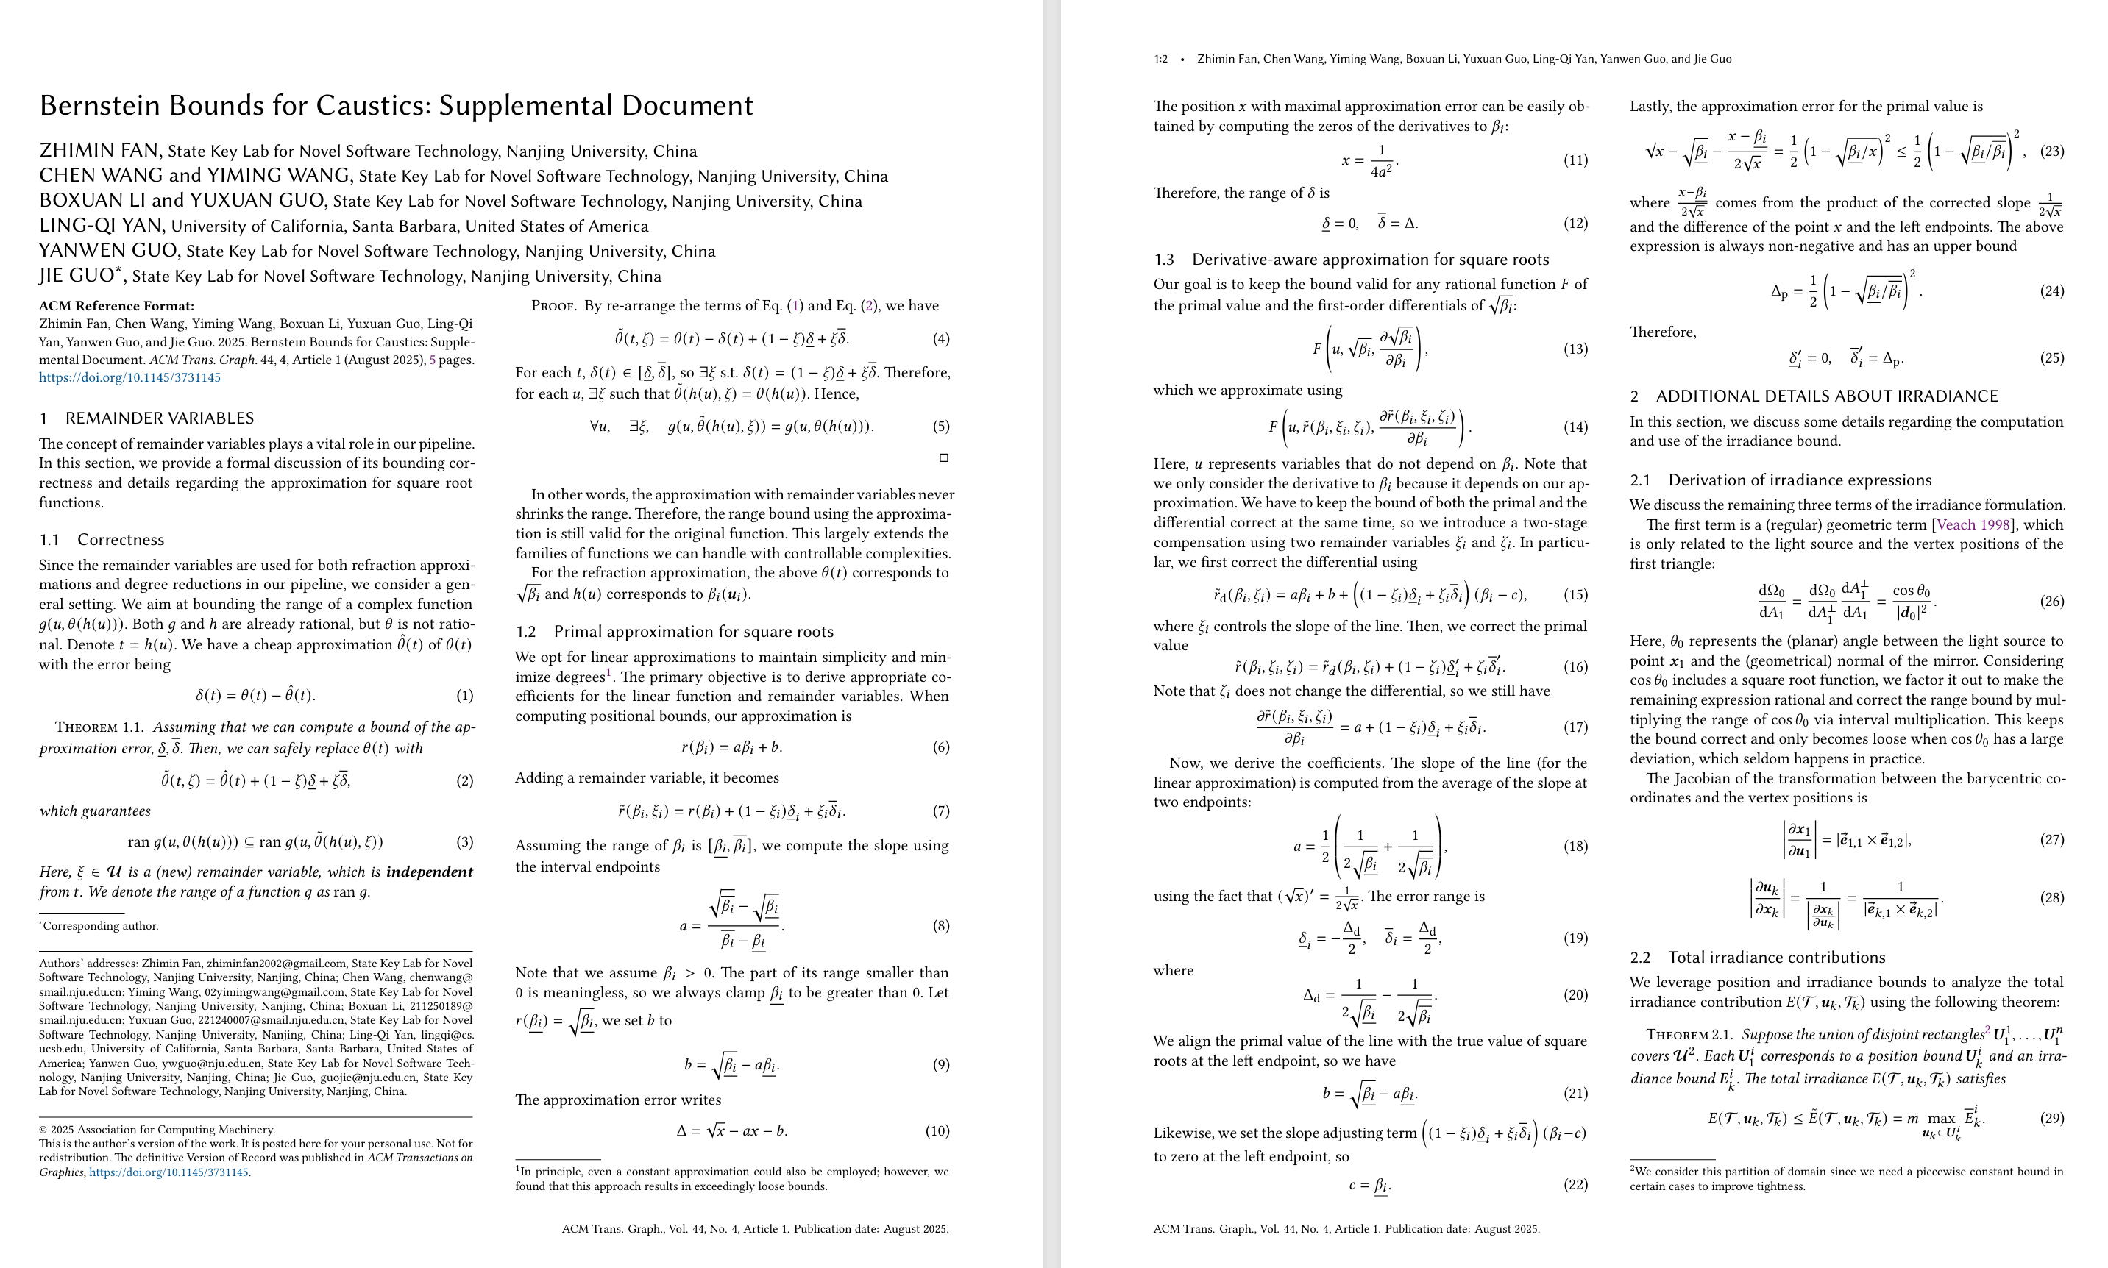
Irradiance: differential remainder variables

Slide 25
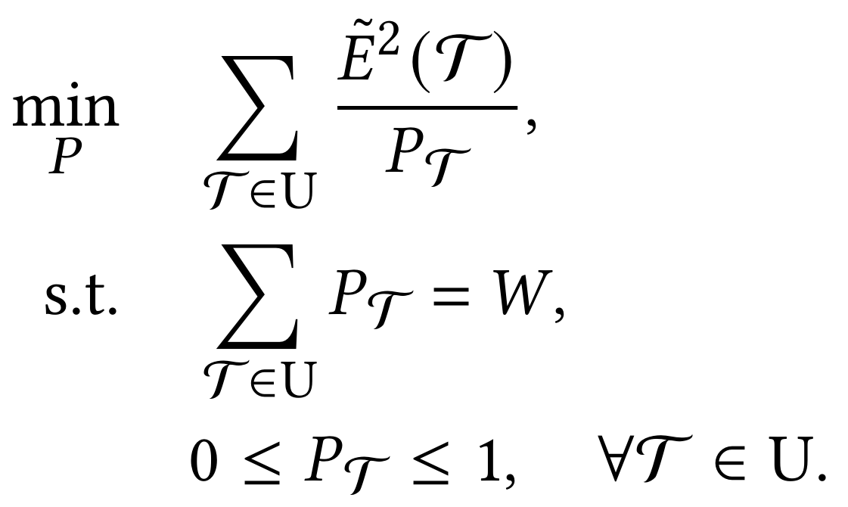
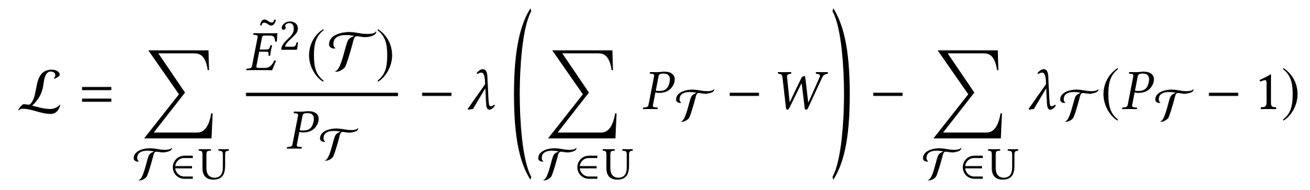
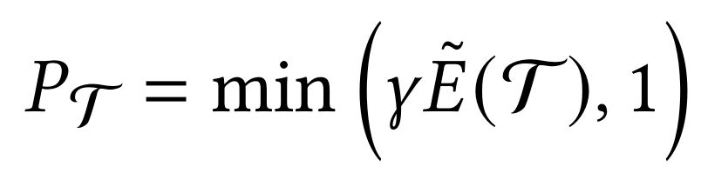
Multi-sample estimator with opt. variance bound

Slide 26
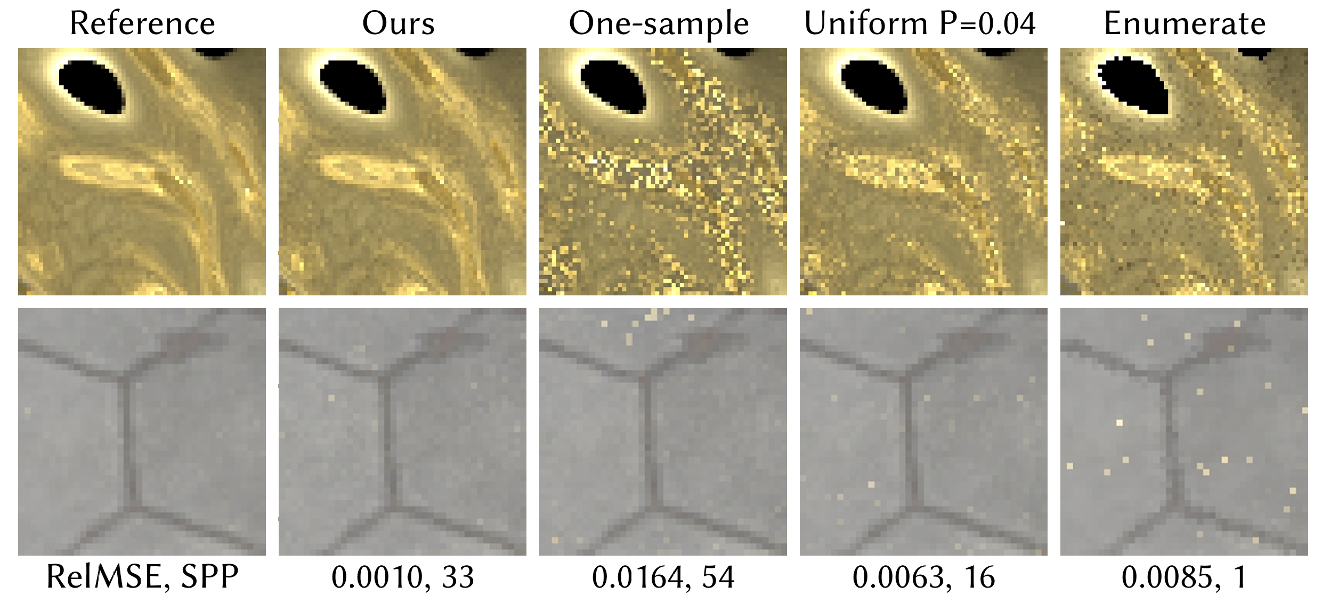
Sample methods

Slide 27
EVALUATIONS

Slide 28
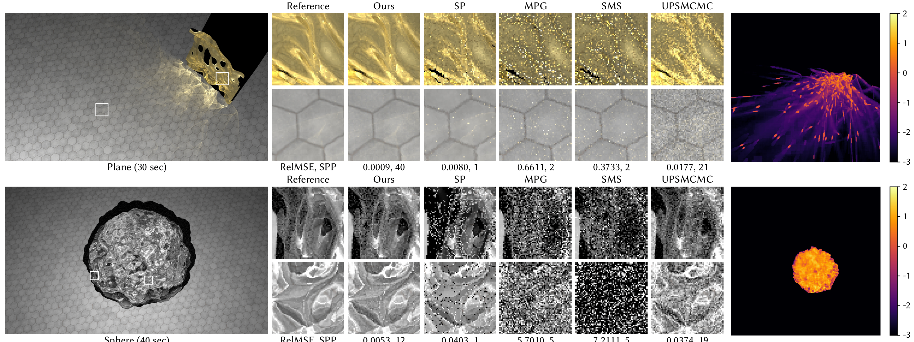
Single scattering

Slide 29
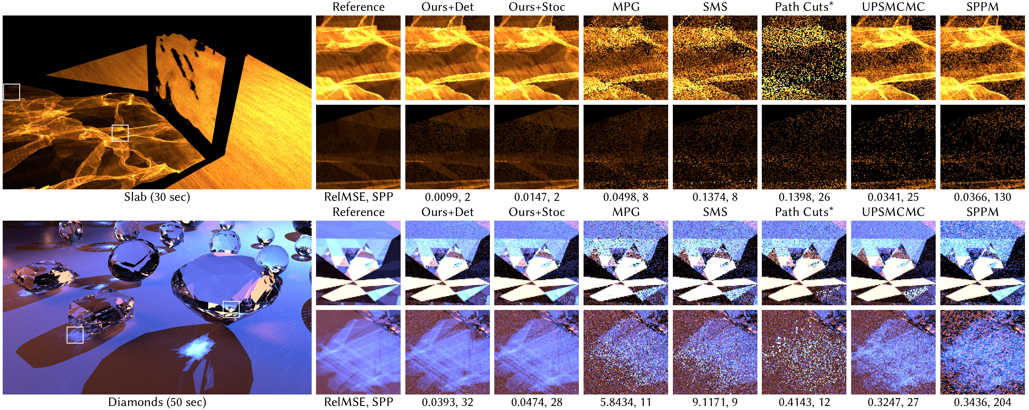
Double scattering

Slide 30
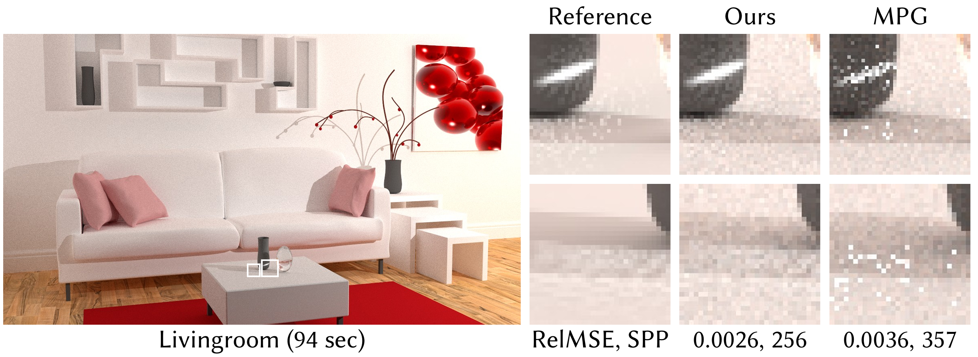
Realistic scenes

Slide 31
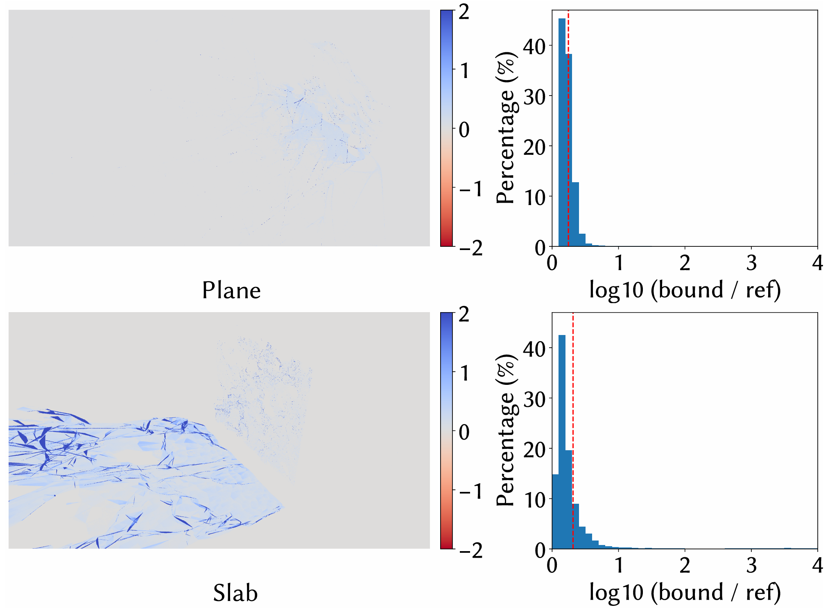
Bounding tightness and validity

Slide 32
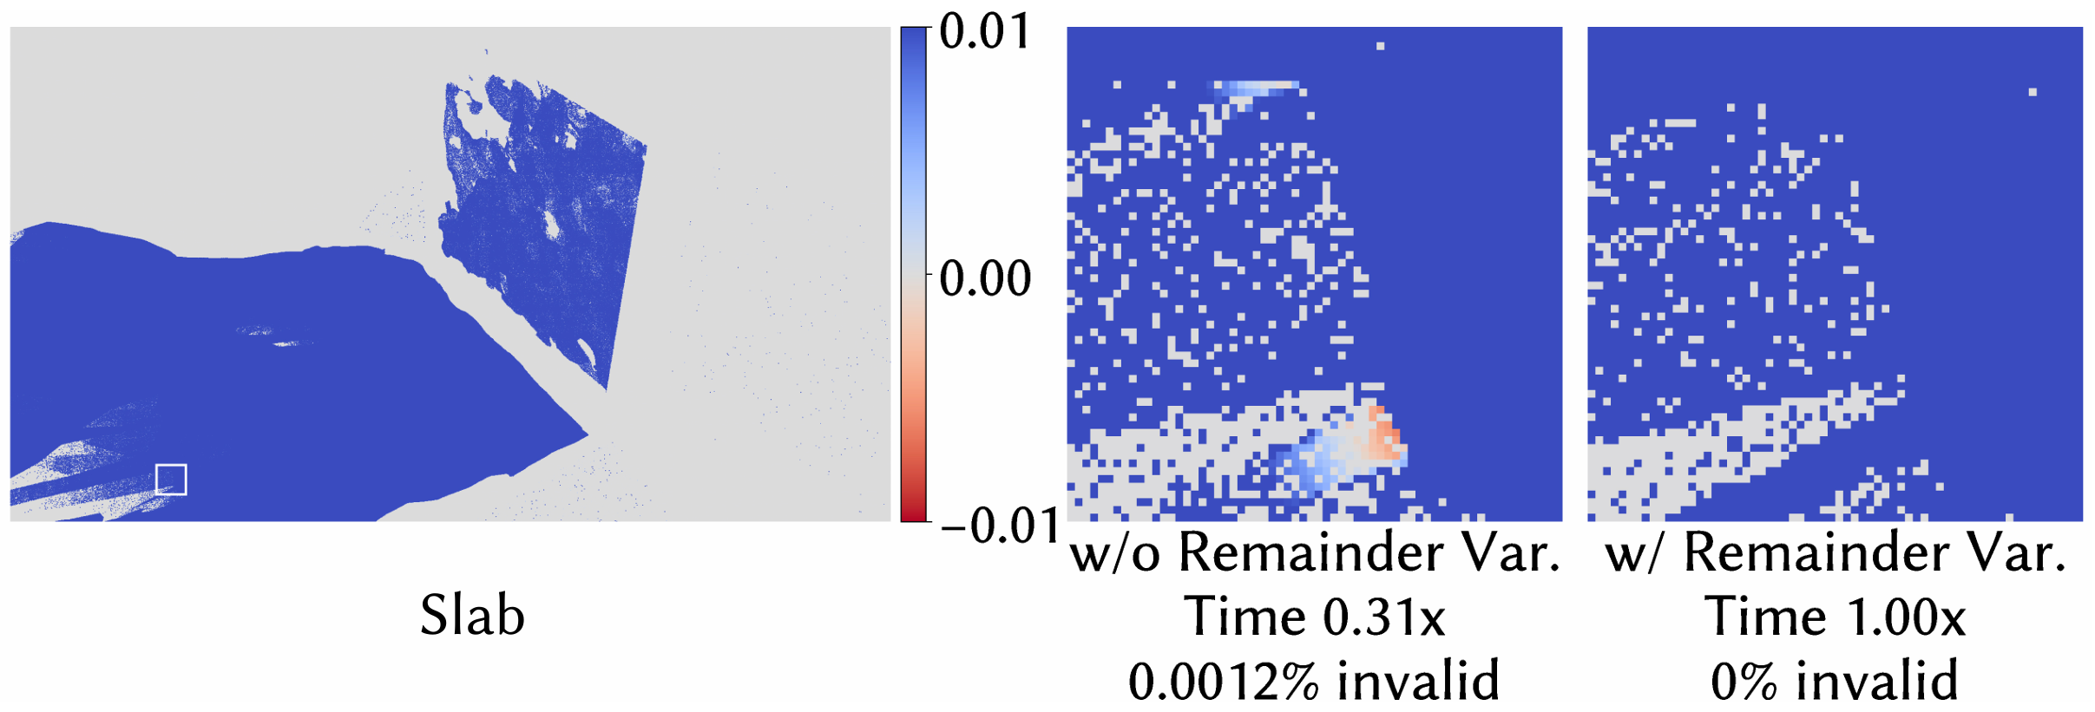
Discussion: remainder variables
Practically, it should be removed
Anyway, “invalid” only leads to higher variance
(log10)

Slide 33
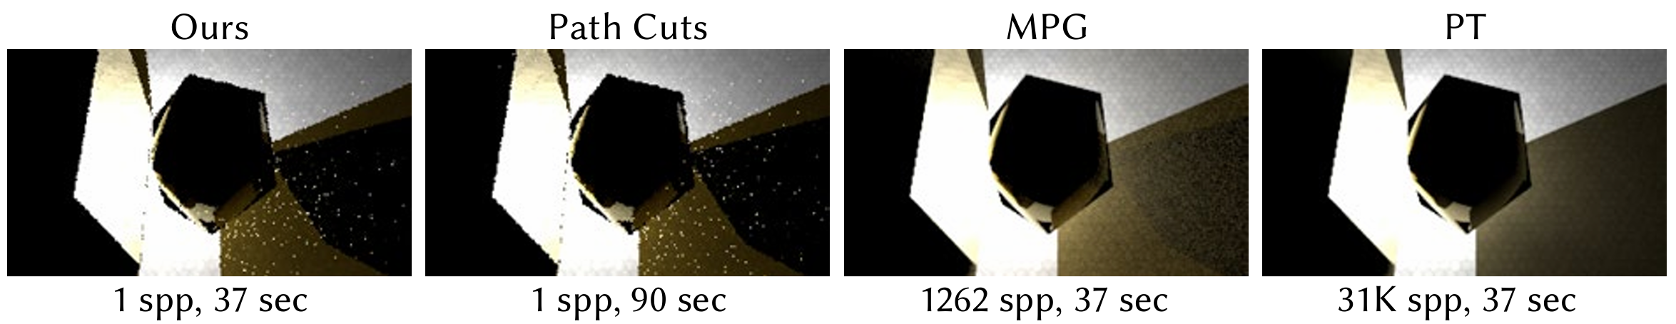
Limitations: 3+ bounces
Triple scattering is tough even for toy cases

Slide 34
Simplifying assumptions
No visibility or Fresnel terms
But still correct; just slower
Mainly for point light
Area light: +2 variables (see the paper for demo)
Pure specular triangles
Also, no clustering employed
Uniform grid (i.e., bitmap) bound storage

Slide 35
Summary
Point sampling
SMS [Zeltner20]
MPG [Fan23]
Region analysis
Path Cuts [Wang20]
Specular Polynomials [Fan24]
Bernstein Bounds [Fan25]
MNEE [Hanika15]
ME [Jakob12]
Spindle Test [Walter09]
Stoc
Stoc
Stoc
Stoc

Slide 36

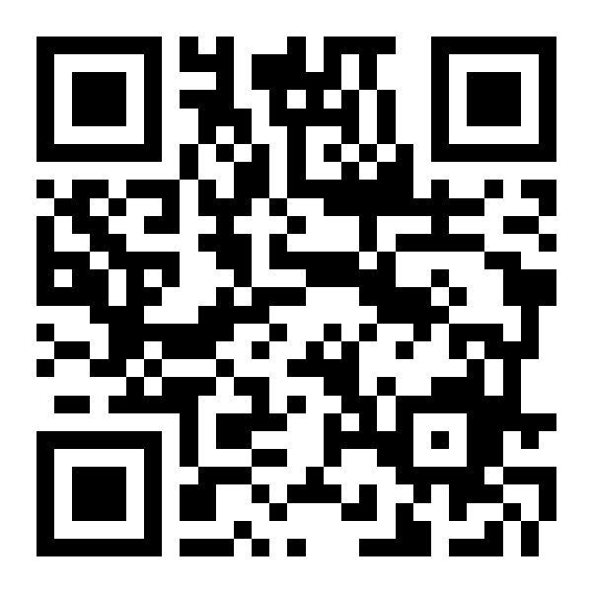
THANK YOU!
Zhimin’s Homepage
Project Page
zhiminfan2002@gmail.com

